Slide 1
NUCLEAR FAMILY

Slide 2
NUCLEAR FAMILY
When parents and their children live in a family, its called a nuclear family.
Only a few members live in a nuclear family.
It’s a small family.

Slide 3
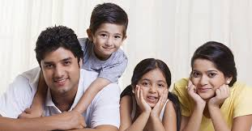
Nuclear families

Slide 4
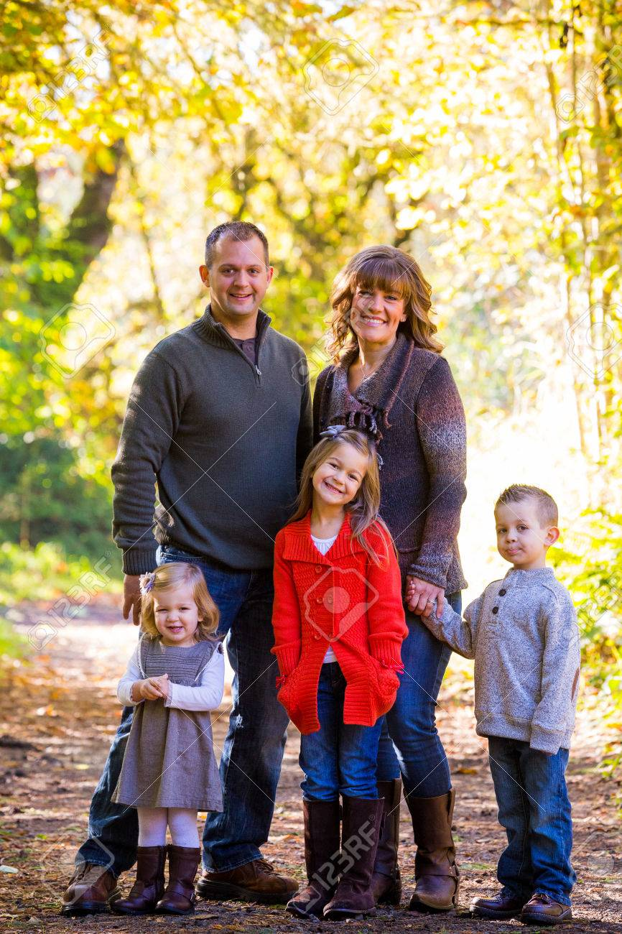

Slide 5
So, in a nuclear family :
Father and mother live with their children.

